Slide 1
StealNova
Affiliate database
Ying Chen
Mike Fleischman
William Madigan
Xingchen Wan

Slide 2
Affiliate Network Database
Track commission, website, revenue, and necessary affiliate information in real time and with ease
The database you’ve been waiting for

Slide 3
Save time and money, all in one place!
Through the efficiency our database will bring you, it will save you a tremendous amount of time
No longer will you need to manage affiliate data in multiple websites
Easily track and manage affiliate earnings and stats instantaneously in one convenient location
Add more affiliates than ever before
Time is money, save time and money

Slide 4
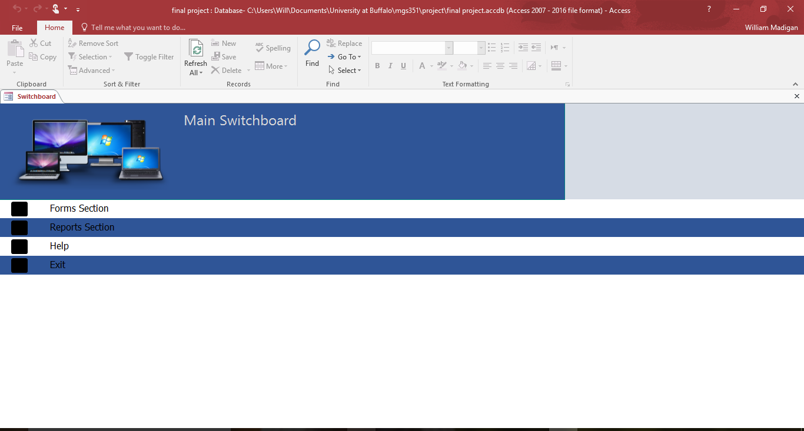

Slide 5
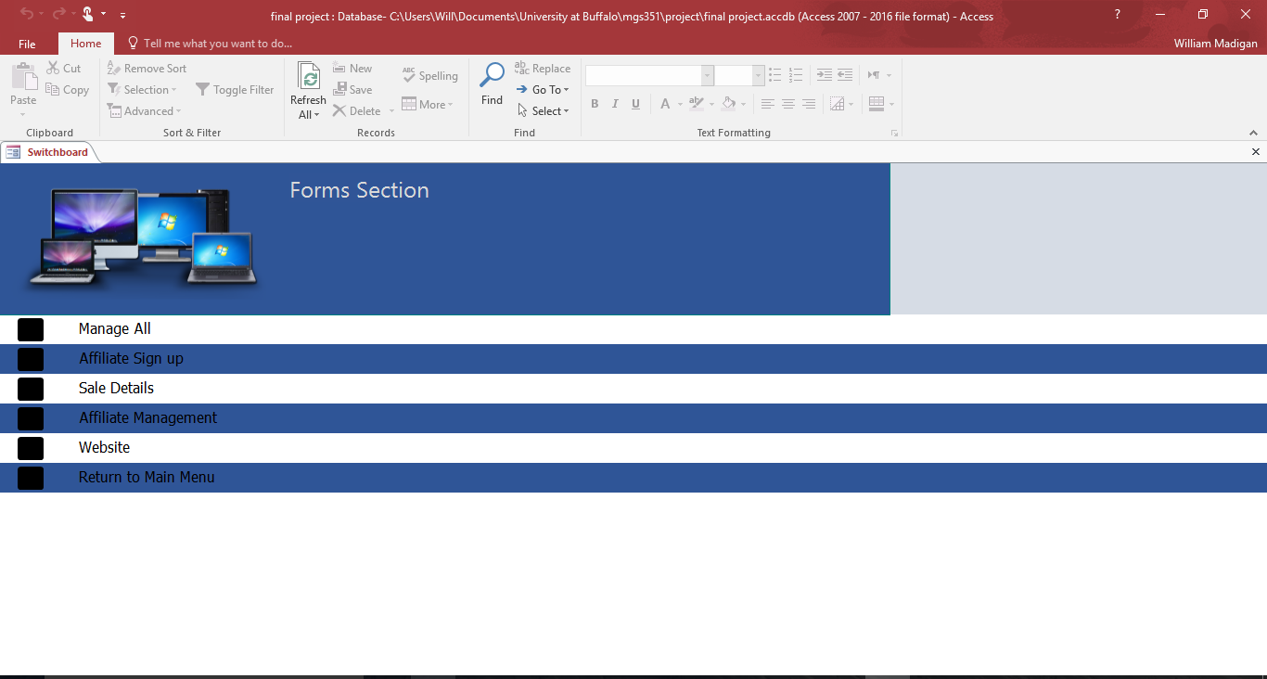

Slide 6
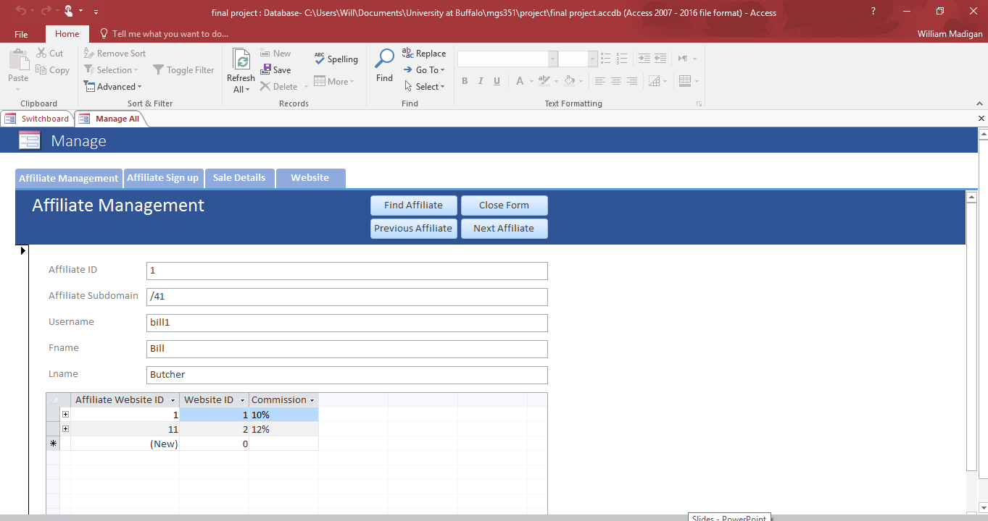

Slide 7
Manage All Form
The Manage All Form is a user friendly interface that allows all the forms to be accessed and utilized within the same display.
It is easily accessible and is very efficient rather than clicking on each form by itself through the switchboard.
Within the affiliate management form you can change each affiliate commission per website

Slide 9
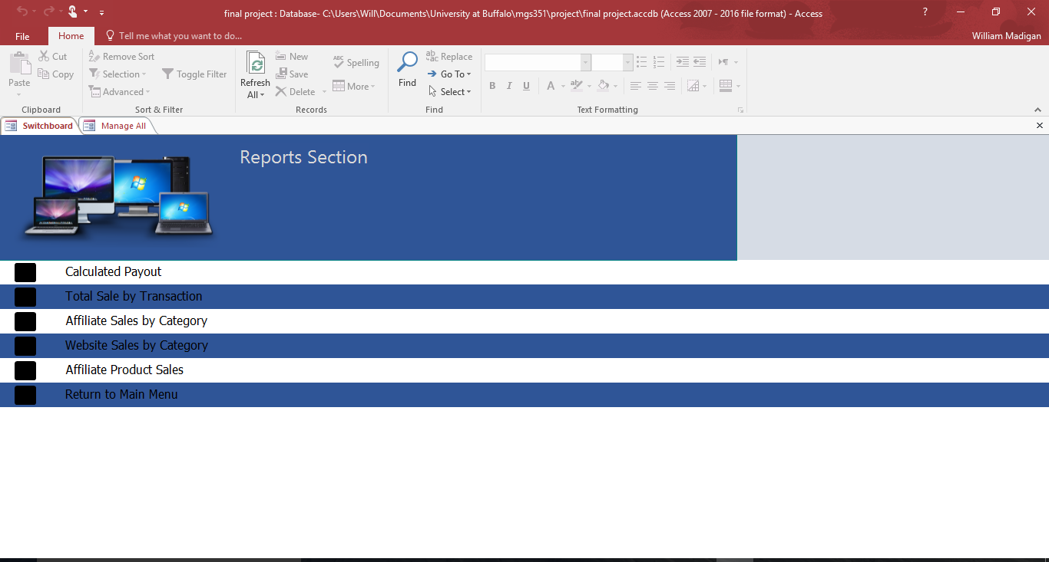

Slide 10
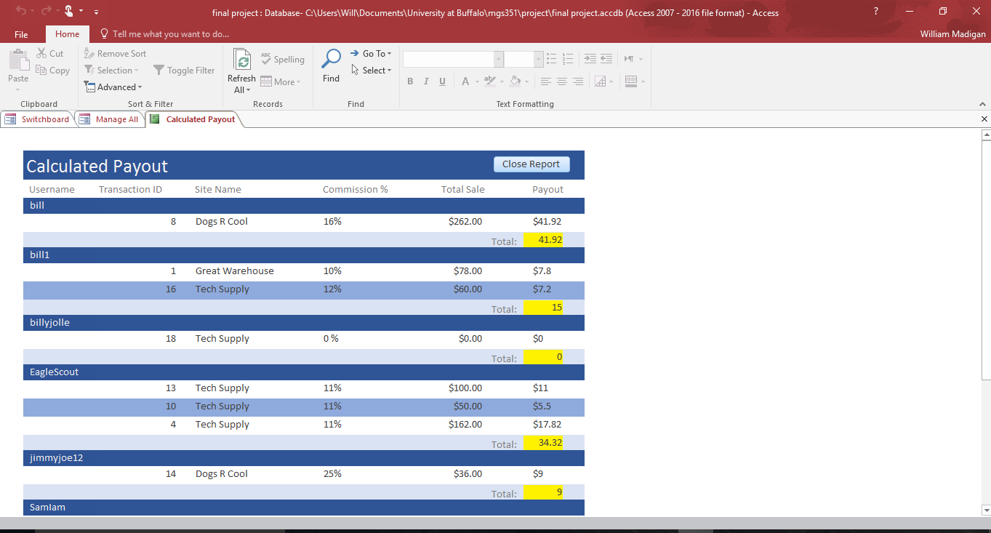

Slide 11
Calculated Payout Report
No longer will you leave affiliates waiting to know their earnings
Now you can instantly provide affiliate earnings through this calculated report
Updated to the minute
Instant and relevant stats!

Slide 12
Increase Ad performance!
Through the data analysis our database provides, you will gain useful insight on what changes and adjustments need to be made
Make better decisions while adjusting:
The Frequency, Content, and Styles of website and ad designs

Slide 13
The database you’ve been waiting for:
Save time
Instant earnings results
Add affiliates instantly
Data protection
Increased ad performance due to analysis
The database you’ve been waiting for!

